Slide 1



NearUs
By: Team Fantastic four

Slide 2

Team Members
Amar Kamalapuri Title: Backend Developer
Devansi Adhikari Title: Frontend Developer
Monjul Boruah Title: Backend Developer
Nikita Sharma Title: Frontend Developer

Slide 3


Limited customer reach
Operational and Setup cost is high
Limited marketing/promotion possibilities
Business expansion is difficult
Not available 24x7
Problems faced
by local businesses

Slide 4



How can our project solve these problems?

Slide 5

01
02
Global customer reach
Operational and setup cost is less
03
04
A broad range of promotion and marketing features available
Global expansion is easier with 24x7 service availability

Slide 6


How is NearUs different?
User Friendly
Unlike large tech giants we do not track the user and seller activity
Easy product return and refund policy

Slide 7
TECHNOLOGIES USED
React
Node.js
HTML & CSS
MongoDB
Cloudinary

Slide 8
How our website looks like from buyer’s side:
Firstly the buyer needs to register themselves as follows: 1. Enter your name 2. Enter your email id 3. Enter the password
Using API they get the location and details of all the shops of the category they chose. Then they can get the timings, address and also the feedback regarding that shop. They can also add them to their favorites.
How our website looks like from seller’s side:
A business owner needs to register themselves as a seller:
1. They need to give a brief description about their shops like address, timings, pictures of their shops, etc.
2. Then they need to select the category of which kind of shop or services they’ll be providing. Categories could be like: pickles shop, grocery etc.
3. After registering, their shops are entered in our database. Now any user near to that shop who wants to buy stuffs which are related would be able to see their shops description.
A buyer will get the details regarding all the shops and services provided by the small business owners near them. Using filter they choose which kind or type of shops they’re looking for.

Slide 9
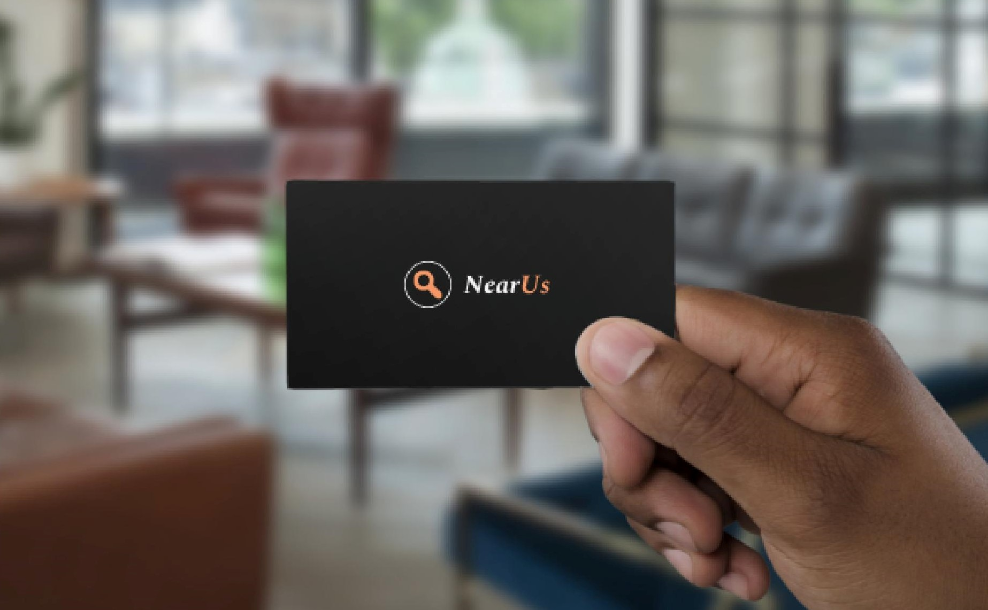
Contact Us
+91-6001088473
monjulboruah@gmail.com

Slide 10


THANK YOU

